Slide 1
Automatic Region of Interest Extraction from Finger Nail Images for Measuring Blood Hemoglobin Level
Link to paper

Slide 2
AIM
Dataset
Feature Selection
The main objective of this paper is to extract region of interest automatically from fingernail images to detect blood hemoglobin level
A dataset comprising 138 subjects was collected and each data comprised of the subjects hand image and blood hemoglobin level.
After extracting the ROI (nails) from the hand image, only red component (RGB values) of the pixels which reside within this detected region are extracted to calculate mean.
This mean value is the input feature for the linear regression model.

Slide 3
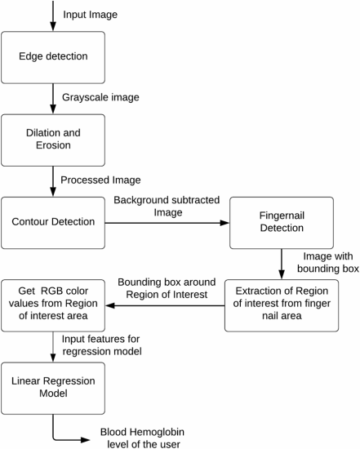
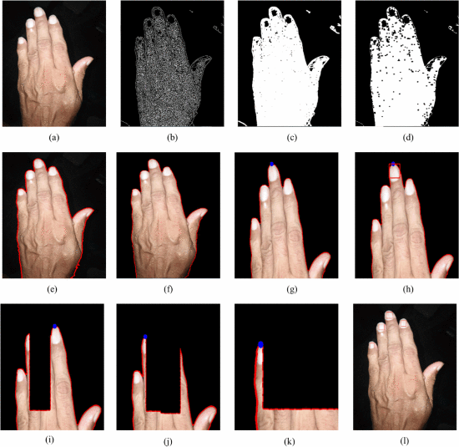
Methodology

Slide 4
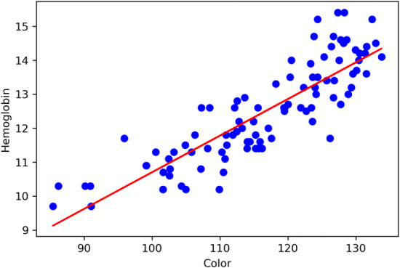

Results
the model after it was trained on the whole data set.
performance measurement of model

